Slide 1
Probabilistic Data Fusion
NC 812/ESD 812

Slide 2
Introduction
Uncertainty lies at the heart of all descriptions of the sensing and data fusion process. An explicit measure of this uncertainty must be provided to enable sensory information to be fused in an efficient and predictable manner.
Probabilistic models provide a powerful and consistent means of describing uncertainty in a broad range of situations and leads naturally into ideas of information fusion and decision making. Probability is the only rational way to model uncertainty (in my opinion).
Probabilistic models sometimes cannot capture all the information that we need to define and describe the operation of a sensing and data fusion system. For example it would be difficult to imagine using probabilistic models alone to capture the uncertainty and error introduced by the dependence of an active electro-magnetic sensor information on beam-width and radiation frequency effects

Slide 3
Fusion Rules
Hard decision Combining
OR, AND, Majority Logic
Soft decision Combining
Log-Likelihood Ratio Test

Slide 4
Fusion
Due to its implementation simplicity 𝑘- out-of-𝑁 fusion rule is common for combining the local binary decisions.
In this case, the central entity will decide that the event of interest has occurred when 𝑘 or more received local decisions are in support.
When 𝑘 = 1, the fusion rule becomes an OR-fusion rule and if 𝑘 = 𝑁, it becomes an AND rule.

Slide 5
Fusion
Let 𝐷_{𝑖} to be the local binary sensing decision of the 𝑖^{th} sensor,
𝐷_{𝑖} = 0 for 𝐻₀ and
𝐷_{𝑖} = 1 for 𝐻₁
Thus the resulting 𝑘-out-of-𝑁 binary hypothesis testing problem is given by
By choosing a common threshold, 𝜆 for each sensor, the global probabilities of detection 𝑄_{𝑑} and false alarm 𝑄_{𝑓} can be obtained

Slide 6
Q_{d} and Q_{f}
The global probability of detection and false alarm can be computed as,

Slide 7
Example
Consider a system where P_{d} is 0.9 and P_{f} = 0.1. If decisions from 9 sensors are available, the resulting Q_{d} and Q_{f} for different fusion schemes is given by,
OR Fusion, k=1,
Q_{d} ~1
Q_{f} = 0.6126
AND Fusion, k=9
Q_{d}=0.3874, Q_{f}~0
Majority Logic, k=5
Q_{d}=0.9991
Q_{f}=0.00089

Slide 8
Probabilistic Fusion
Probabilistic data fusion methods are generally based on Bayes’ rule for combining prior and observation information. Practically, this may be implemented in a number of ways: through the use of the Kalman and extended Kalman filters and so on.
Bayes’ rule lies at the heart of most data fusion methods. In general, Bayes’ rule provides a means to make inferences about an object or environment of interest described by a state x, given an observation z.

Slide 9
Bayes’ Rule
Bayes’ rule requires that the relationship between x and z be encoded as a joint probability or joint probability distribution P(x, z) for discrete and continuous variables respectively.
The chain-rule of conditional probabilities can be used to expand a joint probability in two ways
P(x, z) = P(x|z)P(z) = P(z|x)P(x)
Rearranging in terms of one of the conditionals, Bayes’ rule is obtained
P(x|z) = P(z|x)P(x)/P(z)

Slide 10
Bayes’ Rule
The value of this result lies in the interpretation of the probabilities P(x|z), P(z|x), and P(x). Suppose it is necessary to determine the various likelihoods of different values of an unknown state x.
There may be prior beliefs about what values of x might be expected, encoded in the form of relative likelihoods in the prior probability P(x).
To obtain more information about the state x an observation z is made. These observations are modelled in the form of a conditional probability P(z|x) which describes, for each fixed state x, the probability that the observation z will be made; i. e., the probability of z given x.
The new likelihoods associated with the state x are computed from the product of the original prior information and the information gained by observation.

Slide 11
Posterior Probability
This is encoded in the posterior probability P(x|z) which describes the likelihoods associated with x given the observation z. In this fusion process, the marginal probability P(z) simply serves to normalize the posterior and is not generally computed.
The marginal P(z) plays an important role in model validation or data association as it provides a measure of how well the observation is predicted by the prior.
The value of Bayes’ rule is that it provides a principled means of combining observed information with prior beliefs about the state of the world.

Slide 12
Example
Consider a case where there are 3 types of hypotheses,
X₀: No fire
X₁: May be fire
X₂: Definitely fire
Single sensor observes the event and returns reading z in three ranges.
z₀: No fire
z₁: May be fire
z₂: Definitely fire

Slide 13
Likelihood Matrix
The sensor model is described by the likelihood matrix P (z|X):
Likelihood matrix is a function of both z and X.
For a fixed state, it describes the probability of a particular observation being made (the rows of the matrix).
For an observation it describes a probability distribution over the values of true state (the columns) and is then the Likelihood Function.
 | z0 | z1 | z2
X0 | 0.7 | 0.2 | 0.1
X1 | 0.2 | 0.6 | 0.2
X2 | 0.1 | 0.2 | 0.7

Slide 14
Sensor Model
The conditional probability P(z, x) serves the role of a sensor model and can be thought of in two ways. First, in building a sensor model, the probability is constructed by fixing the value of x = x and then asking what probability density P(z|x = x) on z results.
Conversely, when this sensor model is used and observations are made, z = z is fixed and a likelihood function P(z = z|x) on x is inferred. The likelihood function, while not strictly a probability density, models the relative likelihood that different values of x gave rise to the observed value of z.
The product of this likelihood with the prior, both defined on x, gives the posterior or observation update P(x|z). In a practical implementation, P(z|x) is constructed as a function of both variables (or a matrix in discrete form). For each fixed value of x, a probability density on z is defined. Therefore as x varies, a family of likelihoods on z is created.

Slide 15
Multi-sensor Fusion
The multi-sensor form of Bayes’ rule requires conditional independence
where C is a normalising constant. Equation above is known as the independent likelihood pool. This states that the posterior probability on x given all observations Z^{n}, is simply proportional to the product of prior probability and individual likelihoods from each information source.

Slide 16
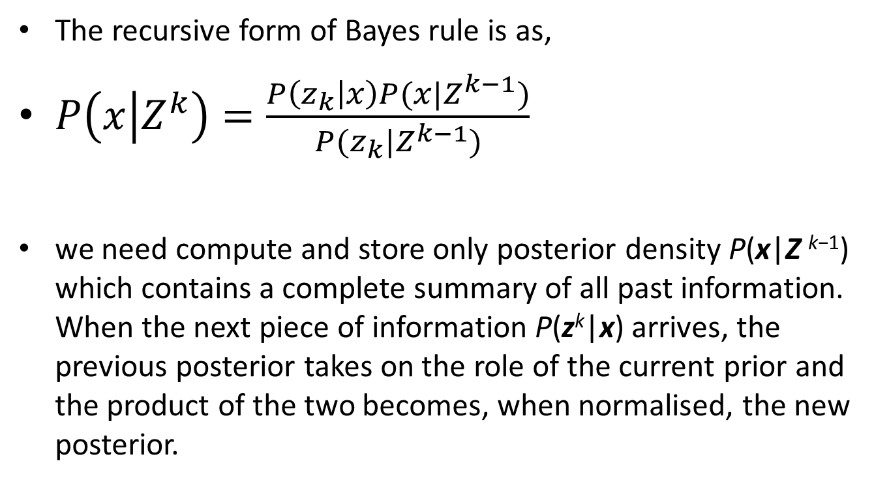
Recursive Bayes Rule
The recursive form of Bayes rule is as,
$P\left(x | Z^{k}\right)=\frac{P\left(z_{k} | x\right)P(x|Z^{k−1})}{P(z_{k}|Z^{k−1})}$
we need compute and store only posterior density P(x|Z ^{k−1}) which contains a complete summary of all past information. When the next piece of information P(z^{k}|x) arrives, the previous posterior takes on the role of the current prior and the product of the two becomes, when normalised, the new posterior.

Slide 17
Bayesian Filtering
Filtering is concerned with the sequential process of maintaining a probabilistic model for a state which evolves over time and is periodically observed by a sensor. Filtering forms the basis for many problems in tracking and navigation.
The general filtering problem can be formulated in Bayesian form. This is significant because it provides a common representation for a range of discrete and continuous data fusion problems without recourse to specific models.
Define x_{t} as the value of a state of interest at time t. This may, describe a feature to be tracked, the state of a process being monitored, or the location of a platform for which navigation data is required. For convenience, and without loss of generality, time is defined at discrete times t_{k}=k.

Slide 18
Bayesian Filtering
At a time instant k, the following quantities are defined:
x_{k}: The state vector to be estimated at time k,
u_{k}: A control vector, assumed known, and applied at time k−1 to drive the state from x_{k−1} to x_{k} at time k,
z_{k}: An observation taken of the state x_{k} at time k.
In addition, the following sets are also defined.
The history of states:
X^{k} = {x₀, x₁, ・ ・ ・ , x_{k}} = {X^{k−1}, x_{k}}.
The history of control inputs:
U^{k} = {u₁, u₂, ・ ・ ・ , u_{k}} = {U^{k−1}, u_{k}}.
The history of state observations:
Z^{k} = {z₁, z₂, ・ ・ ・ , z_{k}} = {Z^{k−1}, z_{k}}.

Slide 19
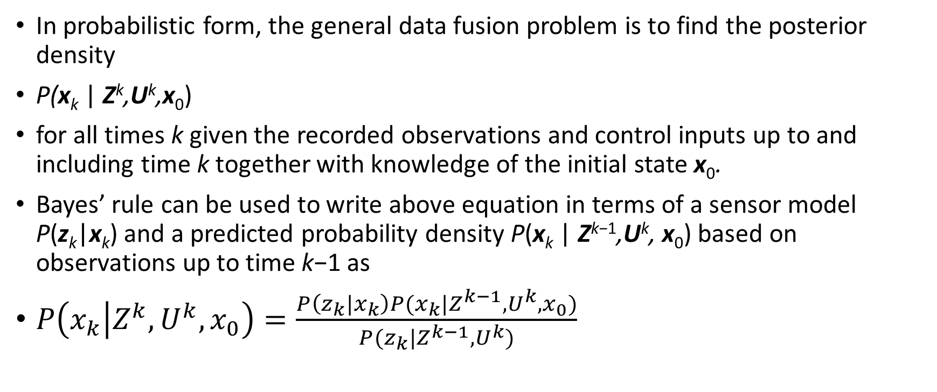
Bayesian Filtering
In probabilistic form, the general data fusion problem is to find the posterior density
P(x_{k} | Z^{k},U^{k},x₀)
for all times k given the recorded observations and control inputs up to and including time k together with knowledge of the initial state x₀.
Bayes’ rule can be used to write above equation in terms of a sensor model P(z_{k}|x_{k}) and a predicted probability density P(x_{k} | Z^{k−1},U^{k}, x₀) based on observations up to time k−1 as
$P\left(x_{k} | Z^{k},U^{k},x_{0}\right)=\frac{P\left(z_{k}|x_{k}\right)P(x_{k}|Z^{k−1},U^{k},x_{0})}{P(z_{k}|Z^{k−1},U^{k})}$

Slide 20
Example
Consider a case where there are 3 types of hypotheses,
X₀: Target 1
X₁: Target 2
X₂: No target
Single sensor observes the event and returns reading z in three ranges.
z₀: Target 1
z₁: Target 2
z₂: No target

Slide 21
Likelihood Matrix
The sensor model is described by the likelihood matrix P (z|X):
Likelihood matrix is a function of both z and X.
For a fixed state, it describes the probability of a particular observation being made (the rows of the matrix).
For an observation it describes a probability distribution over the values of true state (the columns) and is then the Likelihood Function.
 | z0 | z1 | z2
X0 | 0.45 | 0.45 | 0.1
X1 | 0.45 | 0.45 | 0.1
X2 | 0.1 | 0.1 | 0.8

Slide 22
Example
The posterior distribution of the true state x after making an observation z = z_{i} is given by
P(x|z_{i}) = αP(z_{i}| x)P(x)
α is a normalizing constant so that sum, over x, of posteriors is 1.
Assume a non-informative prior: P(x) = (0.333, 0.333, 0.333)
Observe z = z₀, then posterior is P(x|z₀) = (0.45, 0.45, 0.1)
The first column of the likelihood matrix above; the likelihood function given z₁ has been observed. This posterior becomes the new prior and if we observe z = z₁ again, then
P(x|z₀) = αP(z₀|x)P(x)
= α × (0.45, 0.45, 0.1) ⊗ (0.45, 0.45, 0.1)
= (0.488, 0.488, 0.024)

Slide 23
Data Fusion using Bayes Theorem
Consider the set of observations
Z_{n} = {z₁ ∈ Z₁, ・ ・ ・ , z_{n} ∈ Z_{n}} .
Posterior distribution given observation set is naively
P(x|Z_{n}) = P(Z_{n}|x)P(x)/P(Z_{n})
= P(z₁, ・ ・ ・ , z_{n} |x)P(x)/P(z₁, ・ ・ ・ , z_{n})
The joint distribution P(z₁, ・ ・ ・ , z_{n} | x) must be known completely
Assume conditional independence,
P(z₁, ・ ・ ・ , z_{n} | x) = P(z₁ | x) ・ ・ ・ P(z_{n} | x)

Slide 24
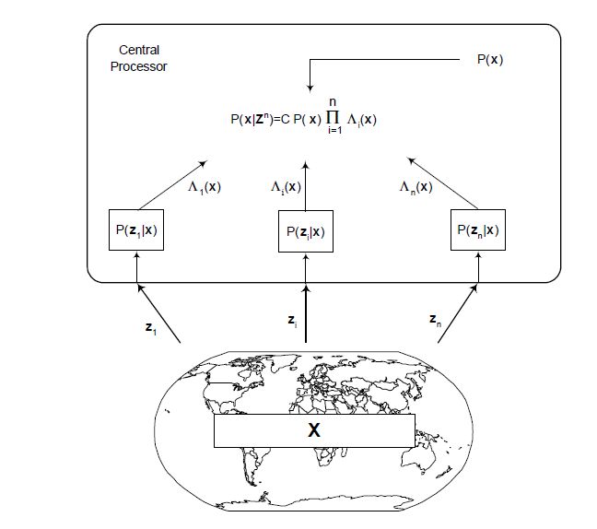
Independence Likelihood Pool

Slide 25
Data Fusion using Bayes Theorem
The effectiveness of fusion relies on the assumption that the information obtained from different information sources is independent when conditioned on the true underlying state of the world.
P(z₁, ・ ・ ・ , z_{n}) = P(z₁) ・ ・ ・ P(z_{n}),
As each piece of information depends on a common underlying state x ∈ X.
Conversely, it is generally quite reasonable to assume that the underlying state is the only thing in common between information sources and so once the state has been specified it is correspondingly reasonable to assume that the information gathered is conditionally independent given this state.

Slide 26
Example
Consider a case where there are 3 types of hypotheses,
X₀: Target 1
X₁: Target 2
X₂: No target
Single sensor observes the event and returns reading z in three ranges.
z₀: Target 1
z₁: Target 2
z₂: No target

Slide 27
Example
Consider a second sensor which makes the same three observations as the first sensor, but whose likelihood matrix P₂(z₂|x) is described by
Whereas the first sensor was good at detecting hypothesis 1 and 2, but not at distinguishing between different target types, this second sensor has poor overall detection probabilities but good target discrimination capabilities.
With a uniform prior, observe z = z0 then the posterior is (the first column of the likelihood matrix)
P(x|z0) = (0.45, 0.1, 0.45)
 | z0 | z1 | z2
X0 | 0.45 | 0.1 | 0.45
X1 | 0.1 | 0.45 | 0.45
X2 | 0.45 | 0.45 | 0.1

Slide 28
Example
It makes sense to combine the information from both sensors to provide both good detection and good discrimination capabilities.
Overall likelihood function for the combined system is
P₁₂(z₁, z₂| x) = P₁(z₁|x)P₂(z₂|x)
Observe z₁ = z₀ and z₂ = z₀ and assuming a uniform prior probability, then posterior is
P(x|z₀,z₀) = αP₁₂(z₀,z₀|x)
= αP₁(z₀|x)P₂(z₀|x)
= α × (0.45, 0.45, 0.1) ⊗ (0.45, 0.1, 0.45)
= (0.6924, 0.1538, 0.1538)
Sensor 2 adds substantial target discrimination power at the cost of a slight loss of detection performance for the same number of observations.

Slide 29
Data Fusion Using Bayes Rule
Repeating this calculation for each z₁, z₂ observation pair:
z1 = z0 (observation from first sensor is z1)
z2 | z0 | z1 | z2
x1 | 0.6924 | 0.1538 | 0.488
x2 | 0.1538 | 0.6924 | 0.488
x3 | 0.1538 | 0.1538 | 0.024

Slide 30
Data Fusion
z1 = z1
z1 = z2
z2 | z0 | z1 | z2
x1 | 0.6924 | 0.1538 | 0.488
x2 | 0.1538 | 0.6924 | 0.488
x3 | 0.1538 | 0.1538 | 0.024
z2 | z0 | z1 | z2
x1 | 0.1084 | 0.0241 | 0.2647
x2 | 0.0241 | 0.1084 | 0.2647
x3 | 0.8675 | 0.8675 | 0.4706

Slide 31
Combined Decision
The combined sensor provides substantial improvements in overall system performance
E.g. we observe z1 = z0 and z2 = z0
P(x | z1, z2) = (0.692, 0.154, 0.154)
Hypothesis 1 most likely as expected
However if we observe z1 = z0 and z2 = z1.
P(x | z1, z2) = (0.154, 0.692, 0.154)
Hypothesis 2 has high probability because sensor 1 does detection while sensor 2 does discrimination.
If now we observe no target with sensor 2, having detected target type 1 (or 2) with the first sensor, the posterior is given by (0.488, 0.488, 0.024).
That is there is a target (because we know sensor 1 is much better at target detection than sensor 2), but we still have no idea which of target 1 or 2 it is as sensor 2 did not make a valid detection.

Slide 32
Combined Decision
If sensor 1 gets no detection, but sensor 2 detects target type 1, then the posterior likelihood is given by (0.108, 0.024, 0.868).
That is we still believe there is no target because sensor 1 is better at providing this information.
Practically, the joint likelihood matrix is never constructed (it is easy to see why here, with n = 3 sensors, and m = 3 possible observations and k = 3 possible outcomes, the dimension of the joint likelihood matrix has k × mn = 27 entries.) Rather, the likelihood matrix is constructed for each sensor and these are only combined when instantiated with an observation.
Storage then reduces to n arrays of dimension k × m, at the cost of a k dimensional vector multiply of the instantiated likelihood functions. This is clearly a major saving in storage and complexity and underlines the importance of the conditional independence assumption to reduction in computational complexity.

Slide 33
Occupation Sensing
Occupancy Sensing: Determine the number of individuals in a room, zone, building, etc.
Track both location and movement of occupants.
Necessary information for efficient use of lighting and environmental conditioning, as well as security.

Slide 34
Problems
Occupancy sensing is typically performed with simple devices: Video cameras, IR motion sensors, optical tripwires, CO₂ detectors, etc. Cameras are in general not a good idea.
Problems with sensor use:
Noisy and/or inaccurate responses.
Expense.
Location optimization.
Generic solutions for unique buildings.
Typically large amounts of data are produced, but only simple analysis is performed.

Slide 35
Goal
Goals:
Use cheap sensors in a distributed network.
Develop new, more sophisticated control algorithms.
Combine sensor inputs through probabilistic
inference to create more accurate occupancy data.
R. H. Dodier, G. P. Henze, D. K. Tiller and X. Guo, “Building occupancy detection through sensor belief networks,” Energy and Buildings, vol. 38, no. 9, pp. 1033 - 1043, 2006.

Slide 36
Sensor Belief Network

Slide 37
Sensor Belief Network

Slide 38
Sensor Belief Network

